Slide 1
Input Output Redirection

Slide 2
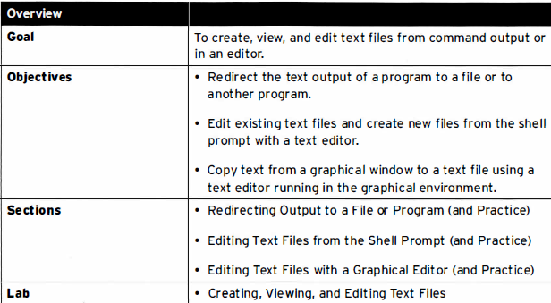
Aim

Slide 3
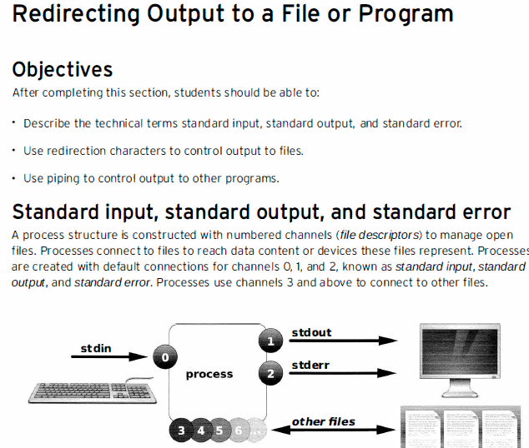

Slide 4
Redirection
Will learn to redirect output of a process to a file or to other processes
1. redirect output of a process to a file
> , >>, 2>, &>
2. Use pipe to control output to other programs
|

Slide 5
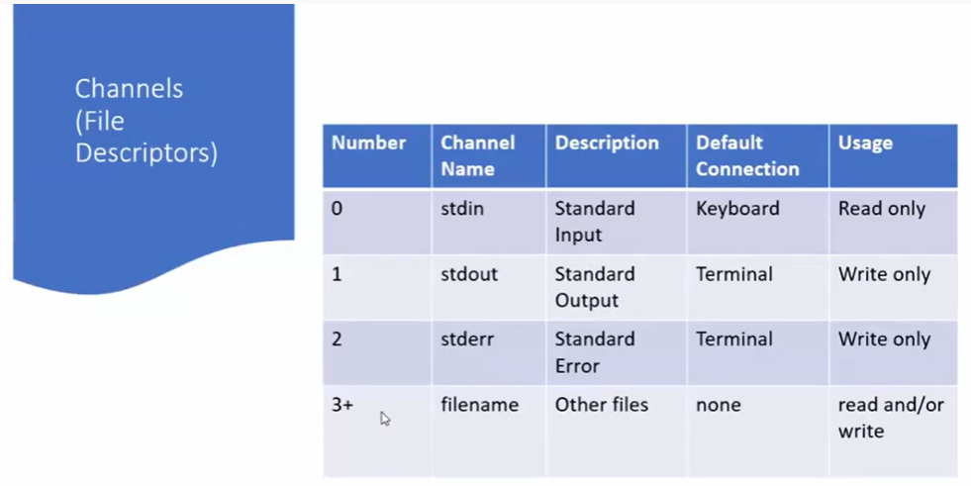

Slide 6

Redirect stdout to a file
Use:
>filename
ls > file.txt
cat file.txt

Slide 7
Append stdout to a file
> Will overwrite the existing content
Use:
>>filename
who >> file.txt
cat file.txt

Slide 8
Redirect stderr to a file
Use:
2>filename
ls qqqq
<error if file does not exist>
ls qqqq 2>error.txt

Slide 9
Discard error message
Neither display the error on screen nor redirect it to a file
2>/dev/null
ls qqqq 2>/dev/null
cat /dev/null {there is nothing in there also}

Slide 10
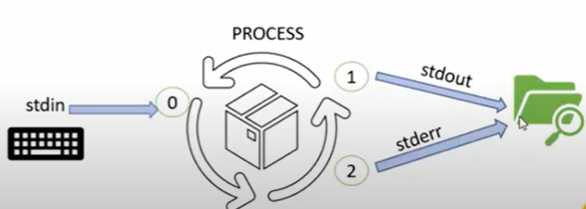
Combine stderr and stdout to a file
Consider a random file,
(which may or may not exist)
ls qqqq &>file.txt
cat file.txt
Now: try the same with existing file

Slide 11
Combine stderr and stdout to a file, append to current file content
ls qqqq >> file.txt 2>&1
cat file.txt

Slide 12
Practice:
Concatenate 3 files into one

Slide 13
Output Redirection
Use pipe | sign
Exp: count total number of files in PWD
ls > file1
wc file1
OR
ls |wc
ls | sort –r | head
ls | wc >file2

Slide 14
Output Redirection
The output from a command normally intended for standard output can be easily diverted to a file instead. This capability is known as output redirection.
If the notation > file is appended to any command that normally writes its output to standard output, the output of that command will be written to file instead of your terminal.

Slide 15
Check the following who command which redirects the complete output of the command in the users file.
$ who > users.txt
Notice that no output appears at the terminal. This is because the output has been redirected from the default standard output device (the terminal) into the specified file “users”. You can check the users file for the complete content −
$ cat users.txt

Slide 16
if a command has its output redirected to a file and the file already contains some data, that data will be lost.
Consider the following example −
$ echo line 1 > users
$ cat users
line 1
You can use >> operator to append the output in an existing file as follows −
$ echo line 2 >> users
$ cat users

Slide 17
Input Redirection
Just as the output of a command can be redirected to a file, so can the input of a command be redirected from a file.
greater-than character > is used for output redirection,
the less-than character < is used to redirect the input of
a command.

Slide 18
For example, to count the number of lines in the file users generated above, you can execute the command as follows −
$ wc -l users.txt
2 users
You can count the number of lines in the file by redirecting the standard input of the wc command from the file users −
$ wc -l < users.txt
2

Slide 19
Discard the output
Sometimes you will need to execute a command, but you don't want the output displayed on the screen.
In such cases, you can discard the output by redirecting it to the file /dev/null −
command > /dev/null
Mkdir new > /dev/null

Slide 20
“command” is the name of the command you want to execute.
The file /dev/null is a special file that automatically discards all its input.
To discard both output of a command and its error output, use standard redirection to redirect STDERR to STDOUT −
command > /dev/null 2>&1
Here 2 represents STDERR and 1 represents STDOUT.

Slide 21
You can display a message on to STDERR by redirecting STDOUT into STDERR as follows −
$ echo message 1>&2

Slide 22
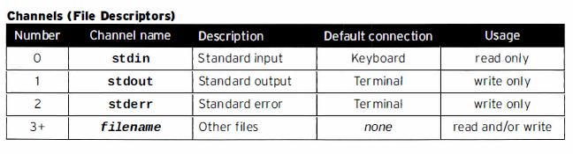

Slide 23
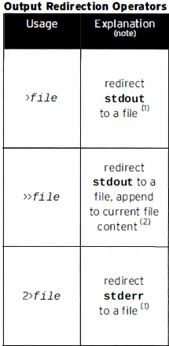
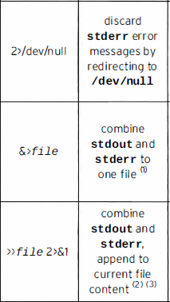
Redirecting output to a file

Slide 24
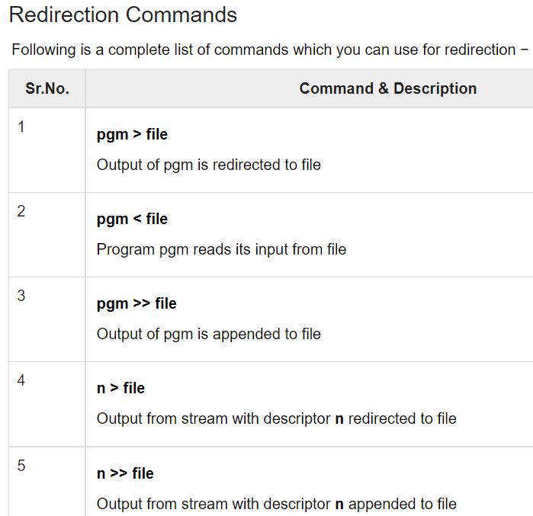

Slide 25
